Slide 1
OR-568 FINAL PROJECT ON BANK DATA TELEMARKETING GROUP-9
BY
Alexander Aguilar
Vinnakota Sai Shashank
Gopishetty Venkata Sri Athulya
Sadineni Naga Charitha
Dhruveeth Pabba

Slide 2
CONTENTS
Dataset Information
Data Pre-processing
EDA Techniques
Data Models
Conclusion

Slide 3
DATA SET DESCRIPTION
This project considers real data from a Tele-Marketing campaign that was done by Portuguese bank from May 2008 – November 2010, this data has been has been extracted from UCI Machine Learning Repository . We have extracted two data sets namely “bank-additional-full.csv”,” bank-additional.csv where the first file is consisting of 41188 records and 21 columns which we have chosen for training of the data, whereas the second one is consisting of 4119 and 21 inputs is been chosen for testing of the data.
The two data sets one is for training the model and other is for validation. Training model consists of 41188 records and 21 features. Validation data set consists of 4119 records and 21 features. From these 21 features, we have 20 explanatory features and 1 response feature or predictor. The observation of predictor says whether the client is subscribed to term deposit.

Slide 4
GOAL
This project mainly utilizes ‘Classification’ techniques to examine a data set related to marketing campaigns of a Portuguese bank. The goal of this project is to predict whether a client subscribes to a term-deposit, classifying the customers into different categories and find some valuable insights which will be helpful for future campaigns.
To achieve these goal we analyse initial data set and performing pre-processing and cleaning the data set, Exploratory data analysis also has been used to visualize the dataset of Explanatory variables and Cross-Tabulation of the metadata categories to determine the distribution of previous Term Deposit acceptance.

Slide 5
DATA PRE-PROCESSING
After check for duplicate records, we found there are 12 duplicate records.
The columns in which missing values in all the entries, housing, loan and default out of these housing and loan have about 990 missing values.
These missing values are in the same row as they are categorical, we can’t perform mean operation to impute the value with the one with highest frequency the difference between yes and no is not so high so we can't impute them with the highest frequency variable.
Even default col has missing values, but the frequency difference of values is high, so we have imputed with the mode.

Slide 6
DATA PRE-PROCESSING
In the data pre-processing tells whether dataset is linear or not, whether it is skewed or not. This analysis helped us in choosing efficient predictive machine learning algorithm. Secondly, Correlation of features here we found some features are strongly correlated which says that they are strongly directly proportional so which helped us to remove the extra features in feature selection.
In this step, the feature engineering where we transformed the data such as categorical data to numerical and then to factoring. The new data set which has been formed was used in machine learning algorithm.
The various machine learning algorithms used are Logistic regression , Decision tree, Random forest, Support vector machine , Gradient boosting method. .

Slide 7
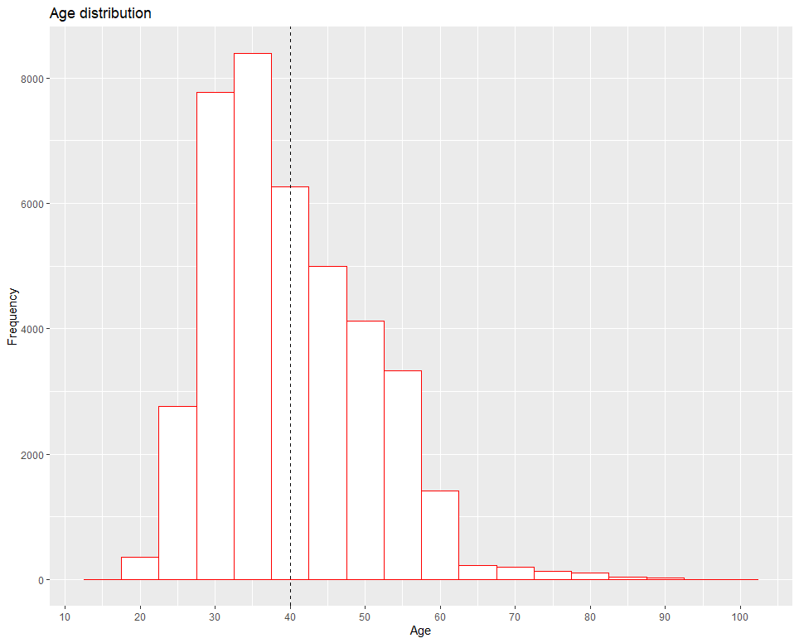
EXPLORATORY DATA ANALYSIS
VISUALIZATION
PART 1
Age Distribution

Slide 8
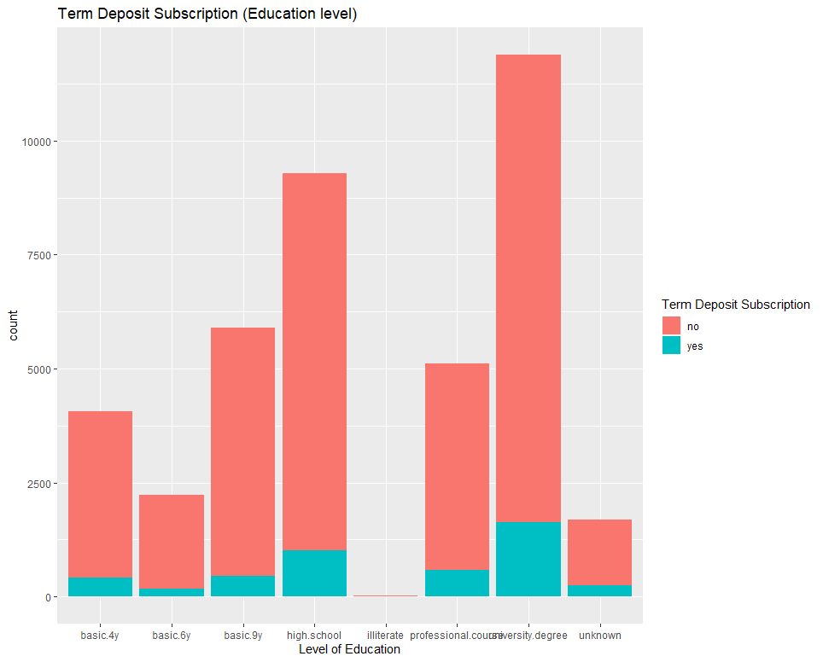
Exploratory data analysis
VISUALIZATION
PART 2
Education Level
Null hypothesis H0: Professional would have accepted more
Alternate Hypothesis Ha: Other education levels would have accepted more.
By the graph we can reject the null hypothesis .

Slide 9
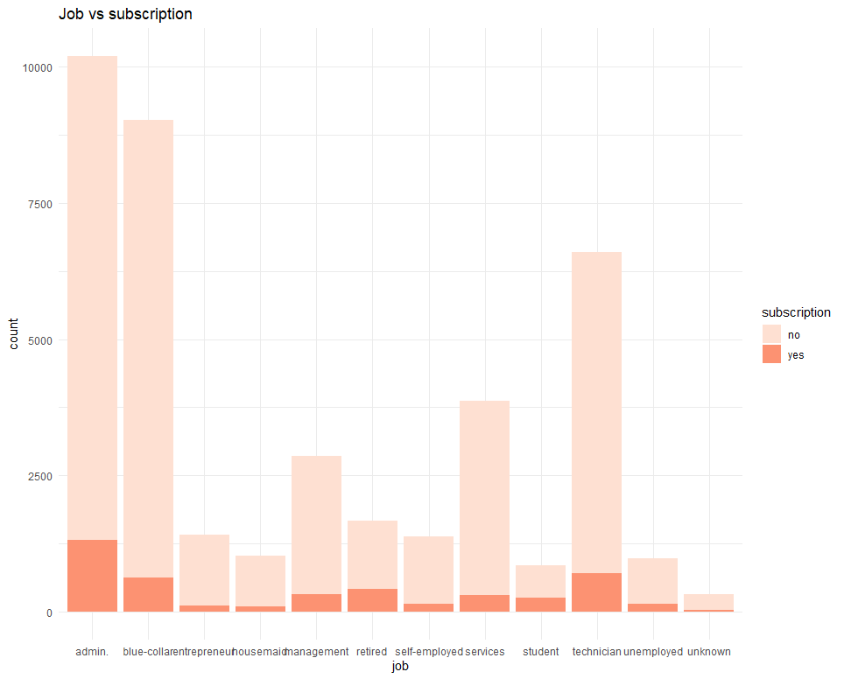
EXPLORATORY DATA ANALYSIS
VISUALIZATION
PART 3

Slide 10
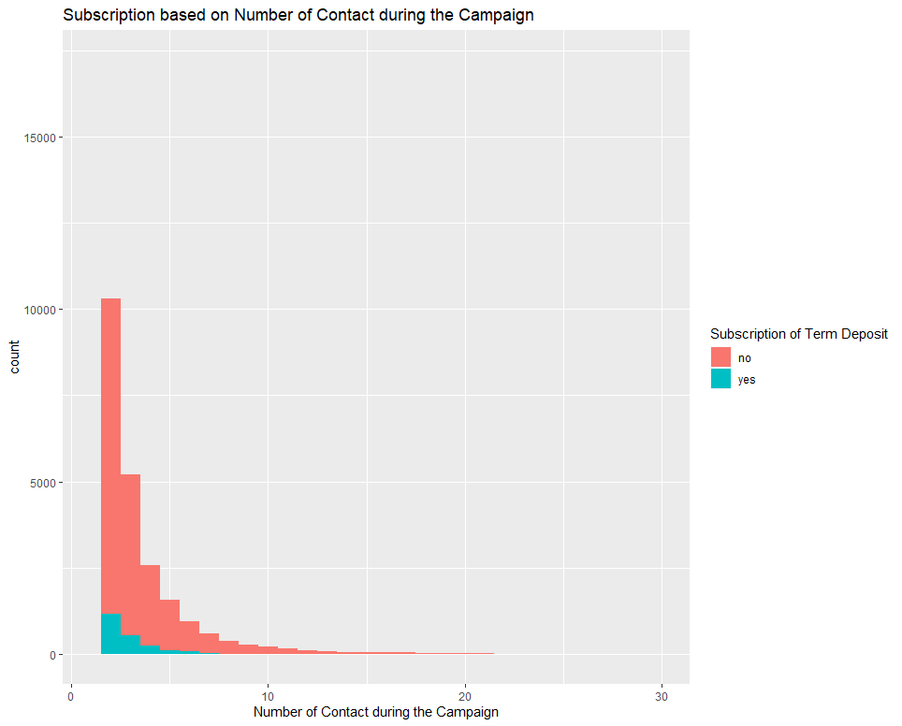
VISUALIZATION
PART 4

Slide 11
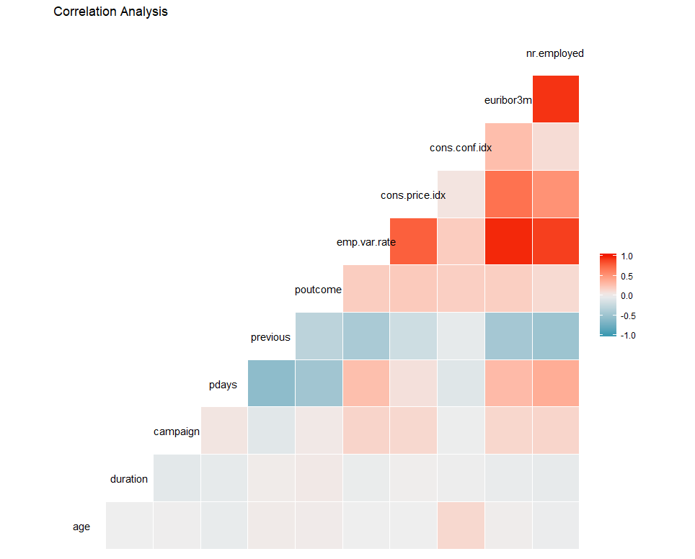
CORRELATION PLOT

Slide 12
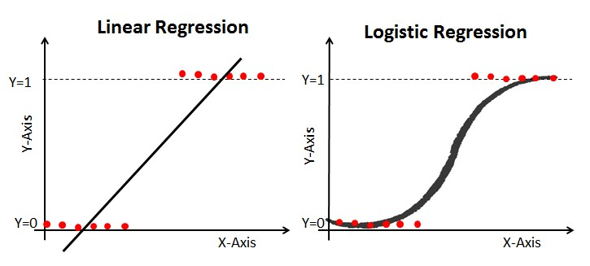

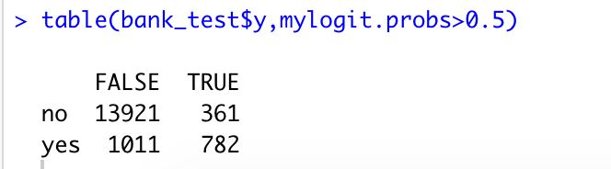
LOGISTIC REGRESSION
Formula:
ACC = (782 + 13921) / 16075
= 0.91
Sensitivity = 782/(782 +1011)
= 0.44
Specificity = 13921/(13921+361)
= 0.97
Precision = 782 / (782+361)
= 0.68

Slide 13
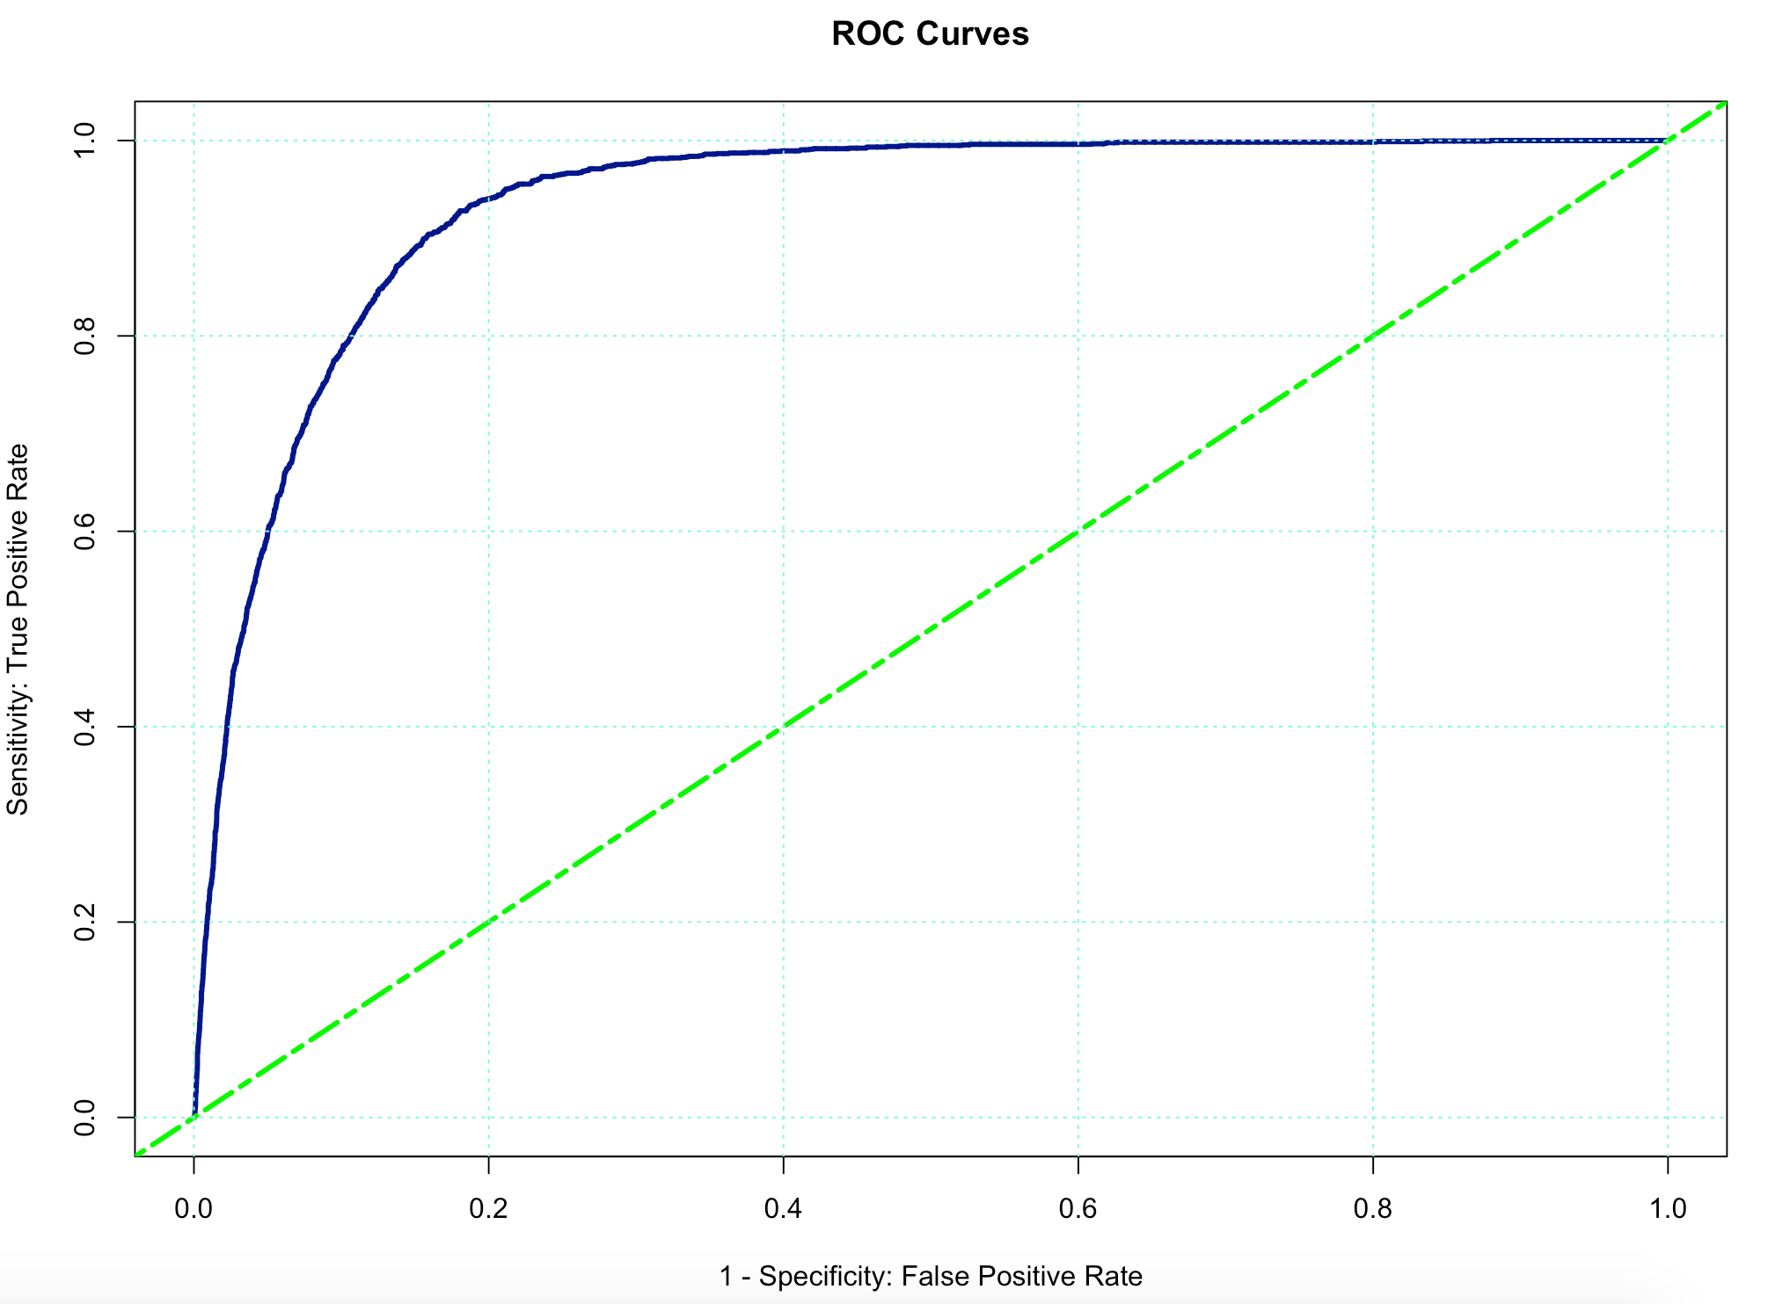
ROC CURVE
The ROC curve is created by plotting the true positive rate (TPR) against the false positive rate (FPR) at various threshold settings.

Slide 14
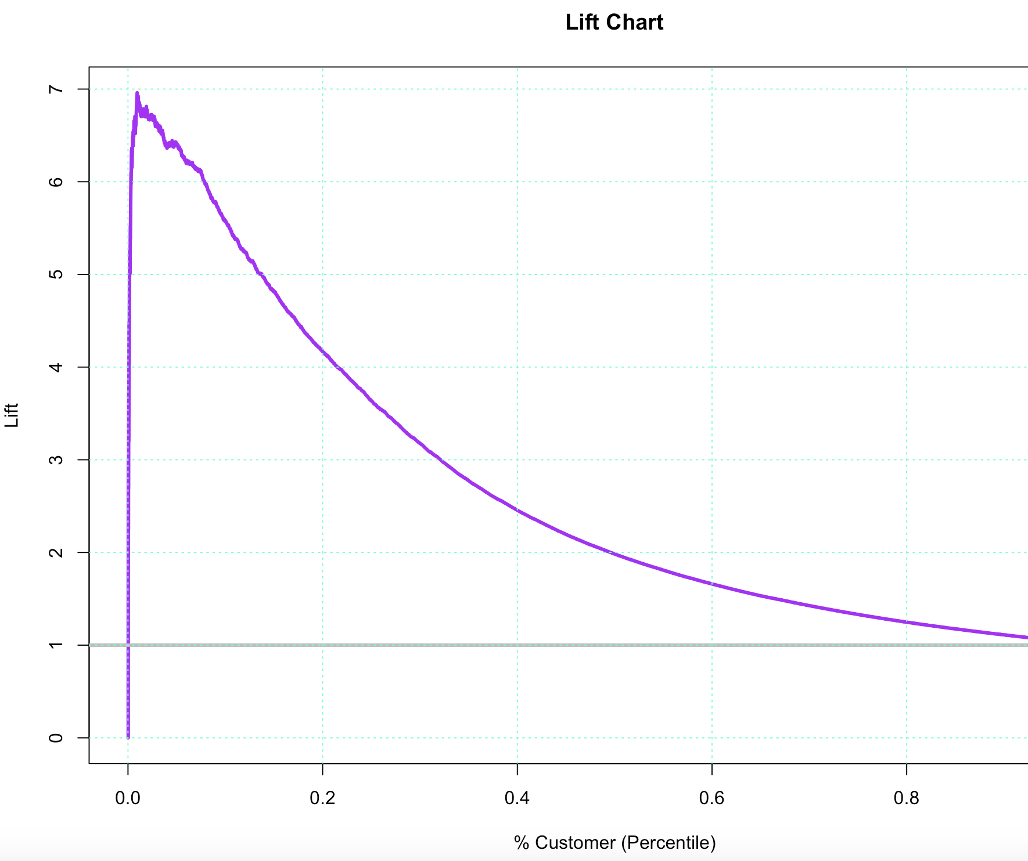
Lift Chart
Lift is a measure of the effectiveness of a predictive model calculated as the ratio between the results obtained with and without the predictive model.
Base line is a reference line without the model.

Slide 15
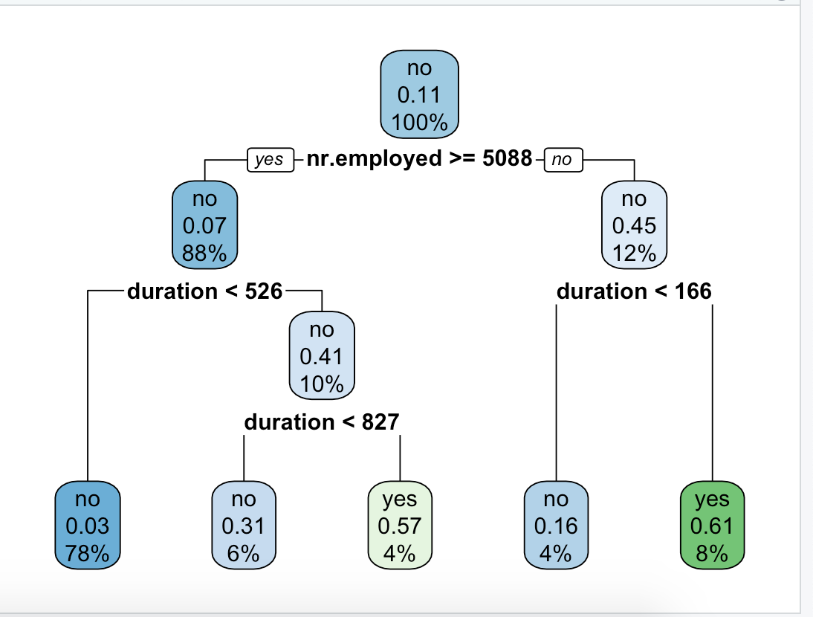
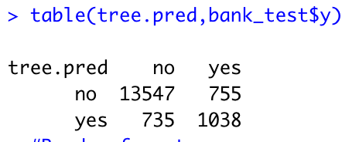
DECISION TREE
Confusion Matrix
Formula:
= 14585/16075
Accuracy= 90.73%

Slide 16
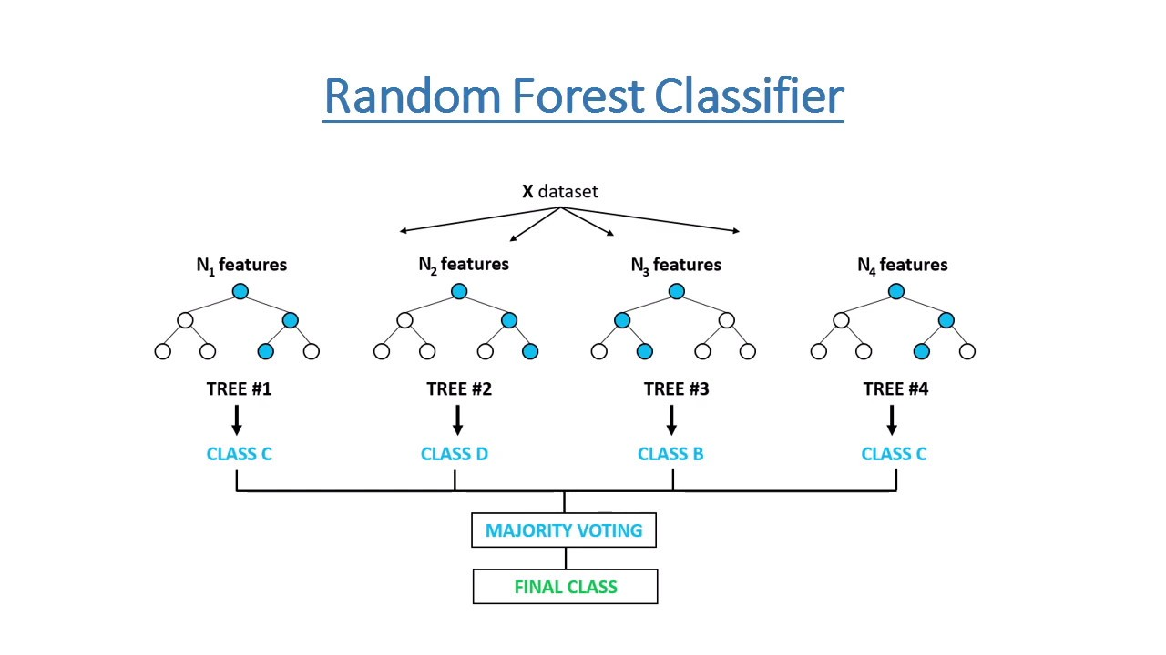
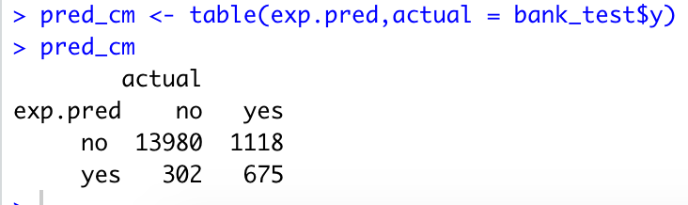
Confusion Matrix
RANDOM FOREST
Formula:
= 14655/16075
Accuracy= 91.16%
Parameters:
mtry=2
do.trace=10
importance = TRUE
ntree = 1000

Slide 17
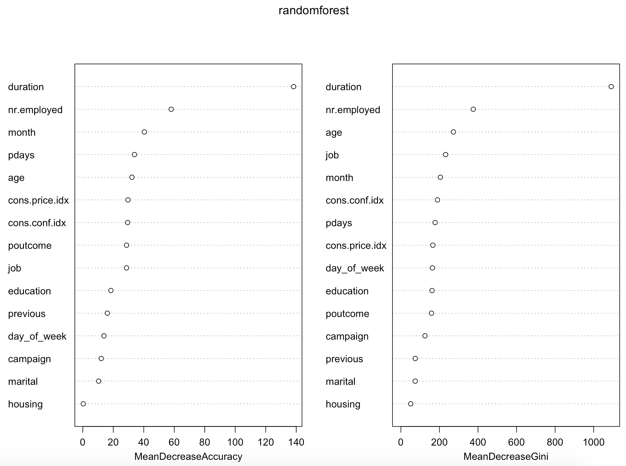
VARIABLE
IMPORTANCE
The variable importance graph gives us the information on which variable contributes better towards the targeting variable.
From the graph, it is evident that Duration has the highest contribution than others.

Slide 18
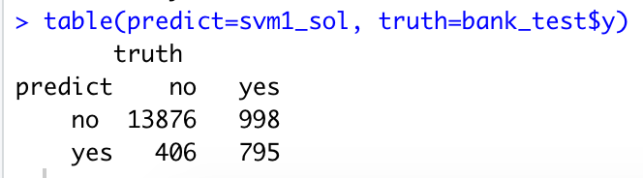
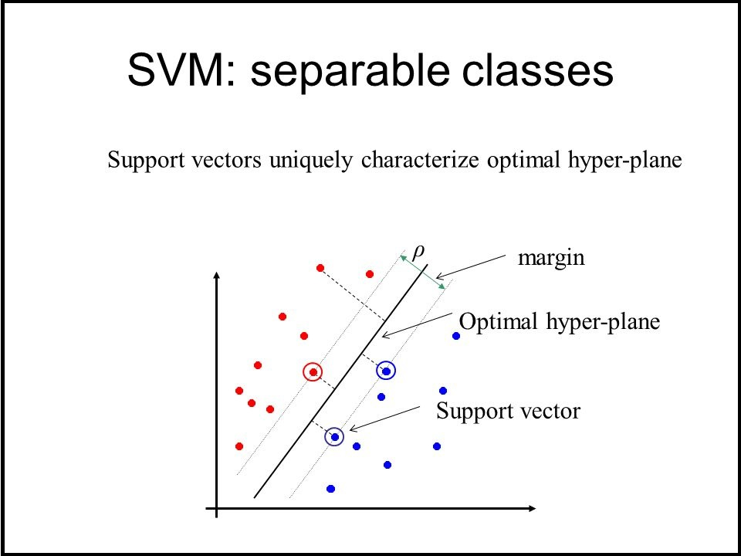
SUPPORT VECTOR MACHINES
Confusion Matrix
Formula:
=14691/16075
Accuracy=91.39%

Slide 19
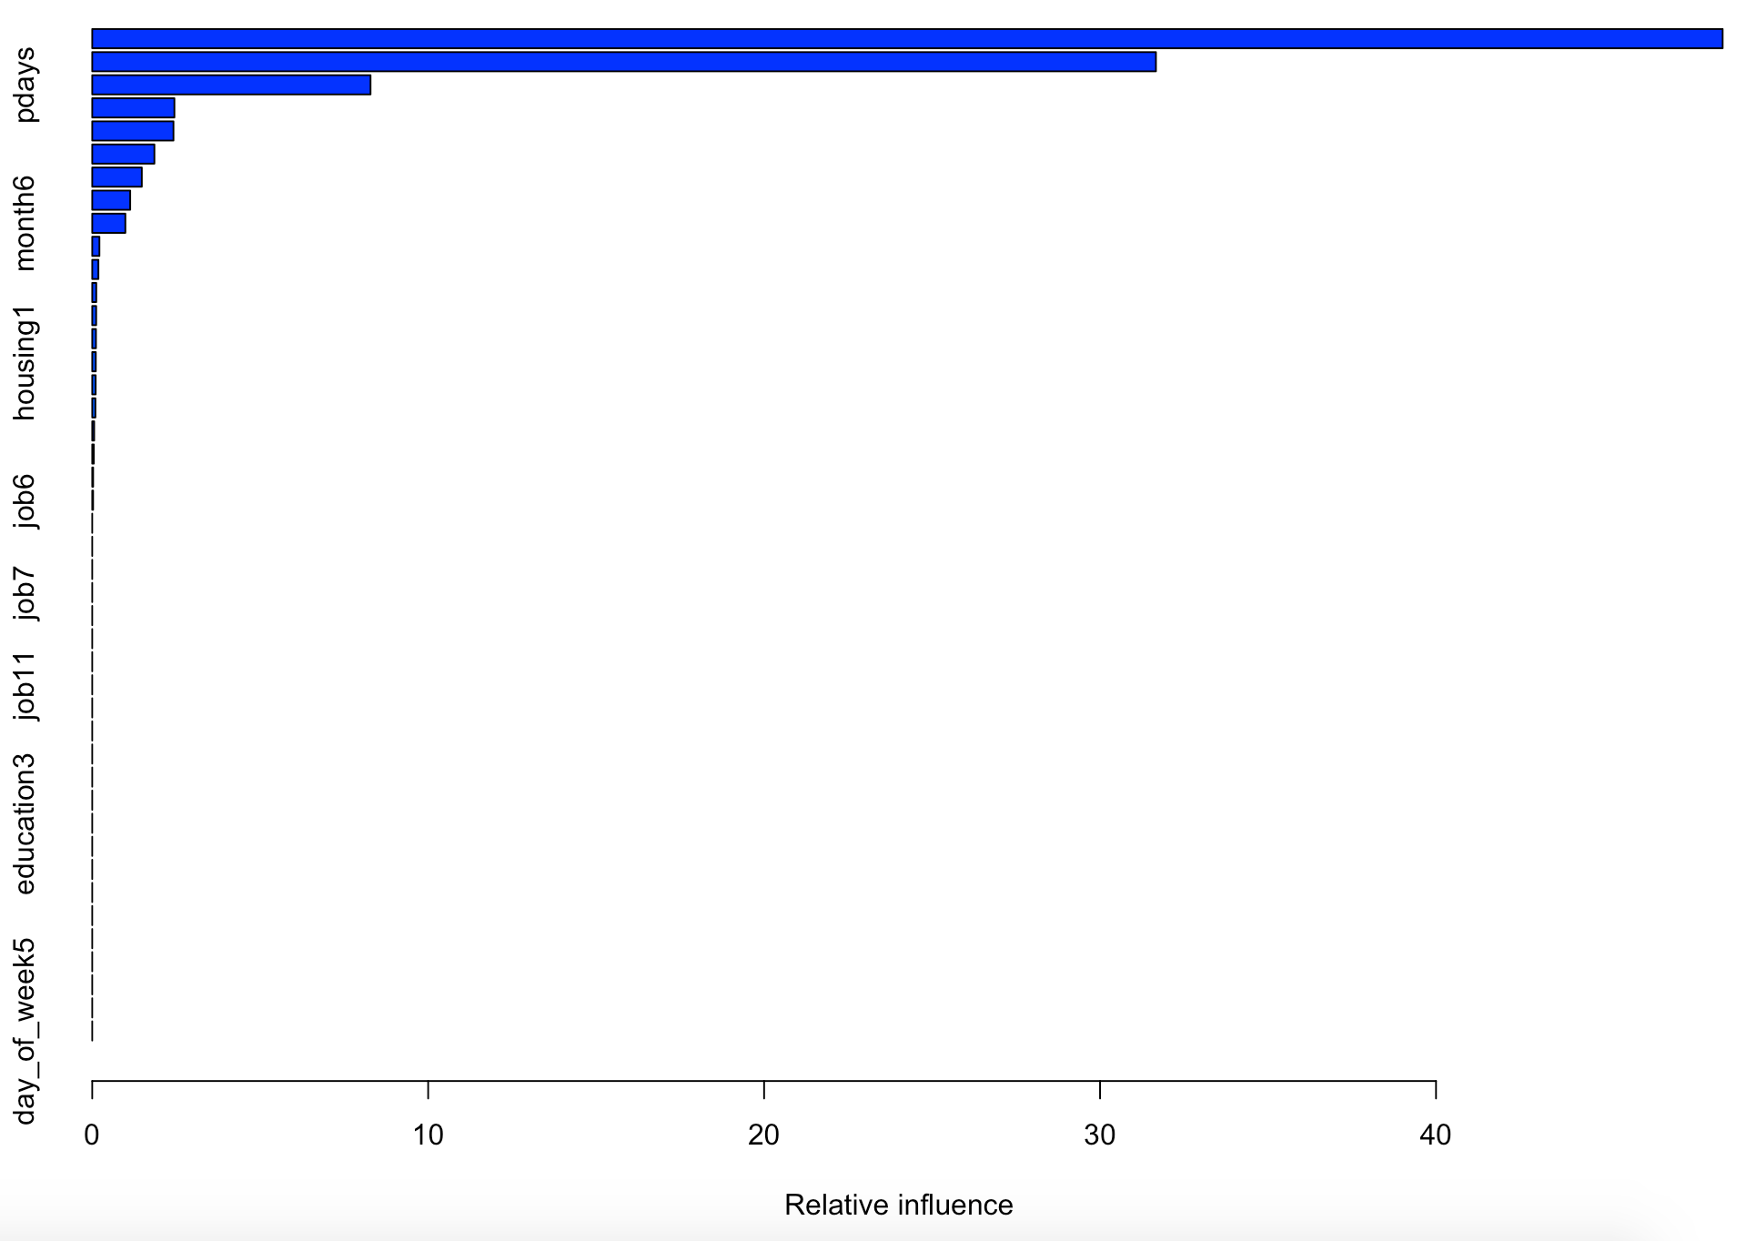
GRADIENT BOOSTING METHOD
Confusion Matrix
Formula:
=14703/16075 Accuracy=91.47%

Slide 20
Conclusion
The accuracy of the Gradient Boosting Method is 91.47%
Accuracy of the Logistic Regression Method is 91.46%
Accuracy of the Support Vector Machine Model is 91.39%
Accuracy of the Random Forest Model is 91.16%
The accuracy of the Decision Tree Model is 90.73%
The accuracy of the GBM is high because it learns from the earlier classification and it tries to correctly classify the Mis-classifiers from the previous classification.
Based on these models using the important variables, we are able to accurately predict if an individual is willing to have term deposit subscription.

